Slide 1

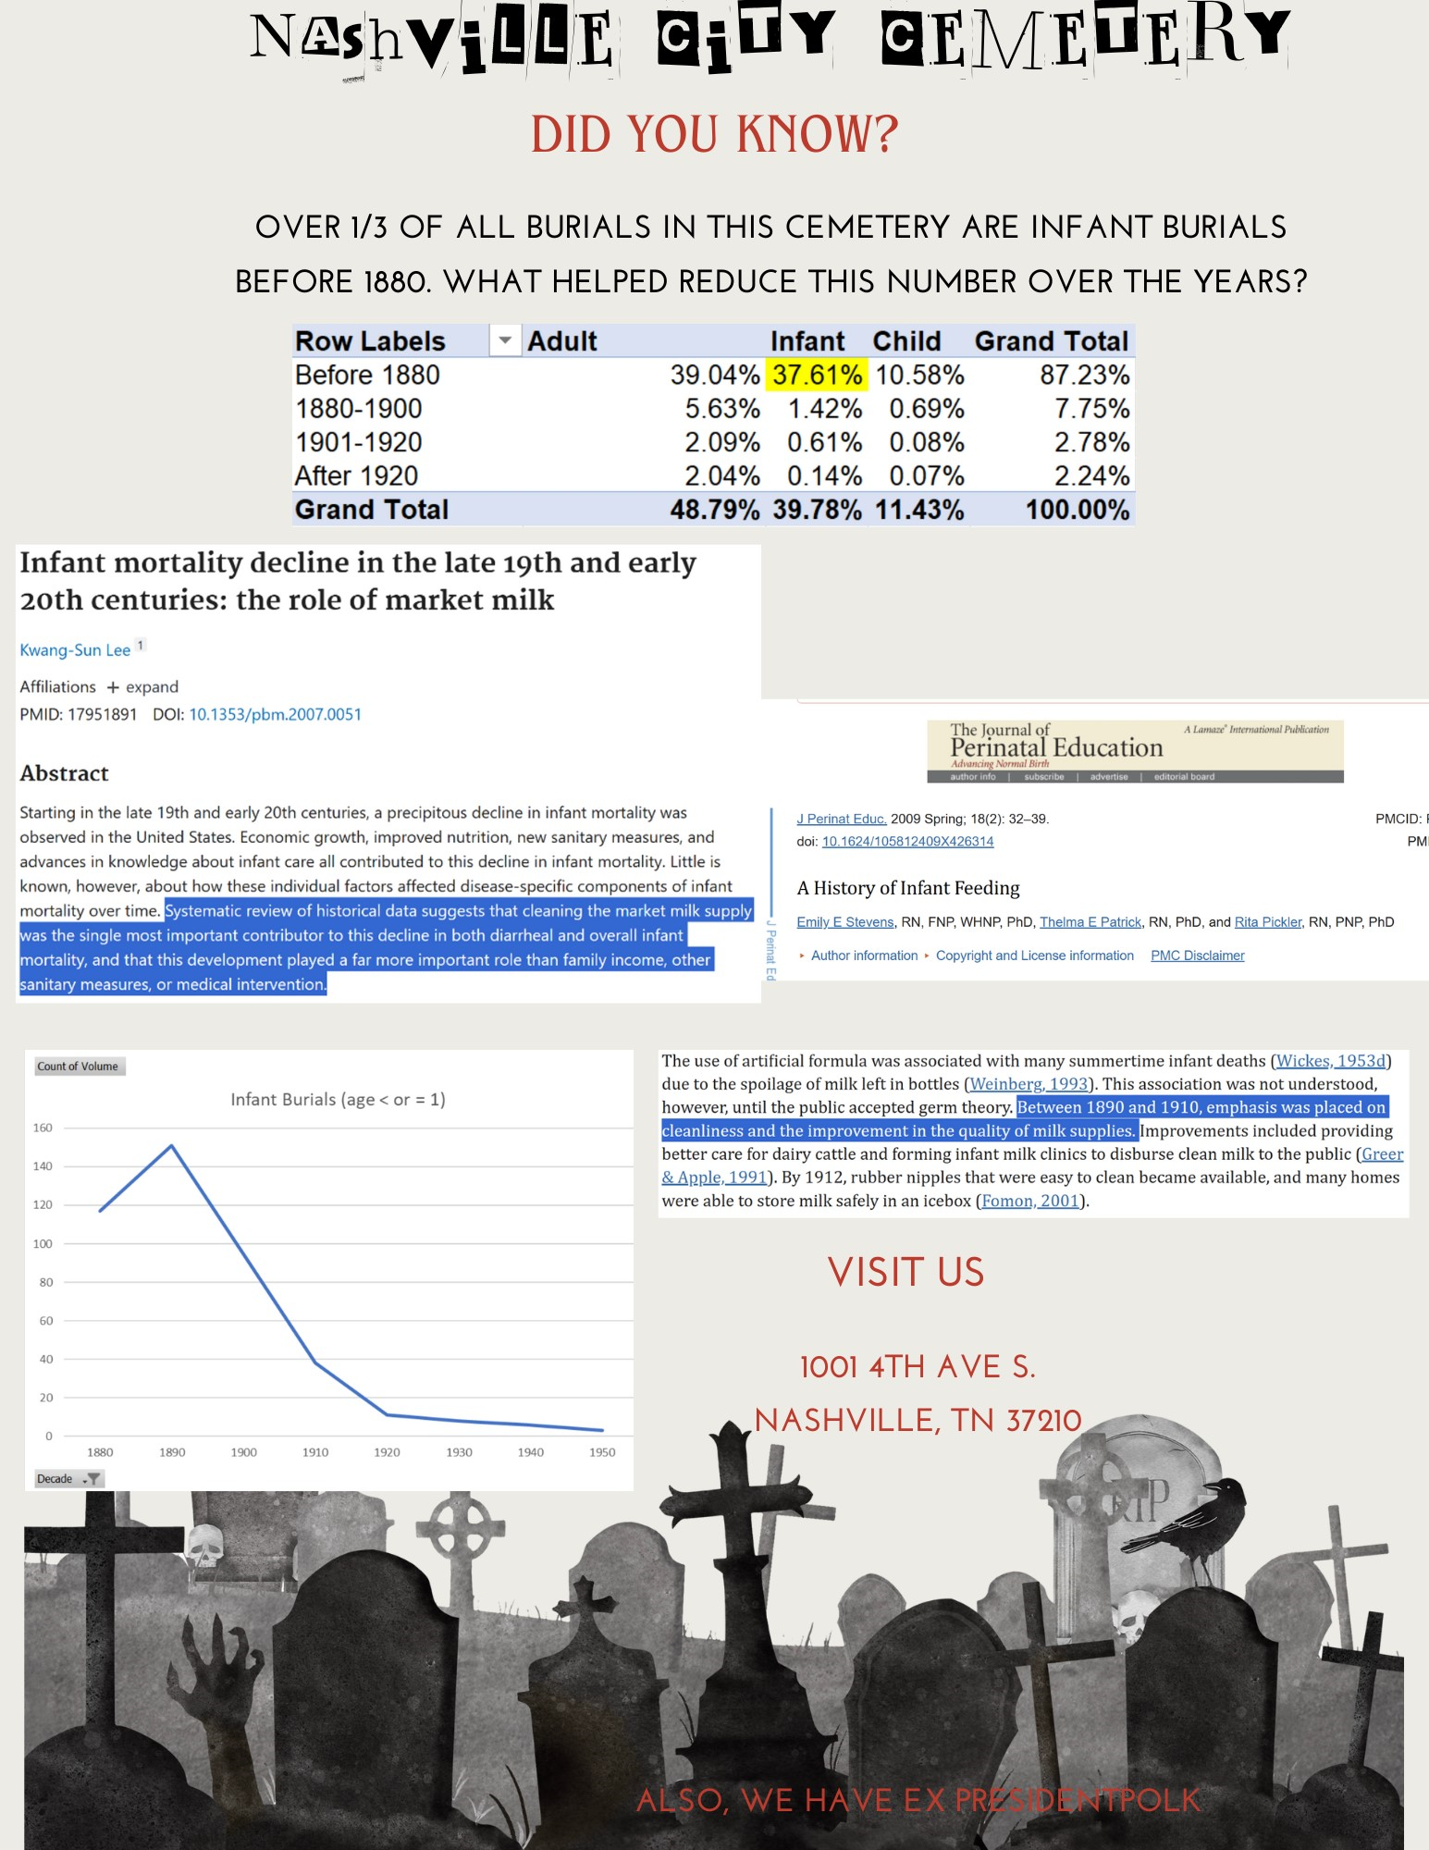

Slide 2
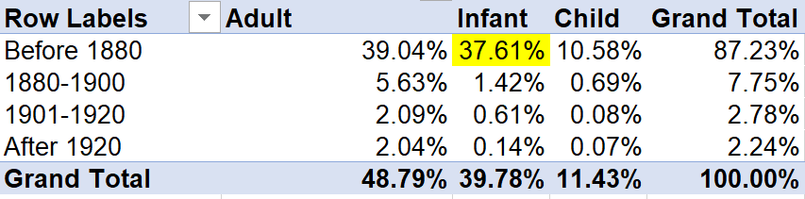
Nashville City Cemetery “Fun” Fact
Did you know..?
More than a third of all burials in this cemetery are infant burials before 1880.
You might wonder what changes helped lower this number after 1880?

Slide 3
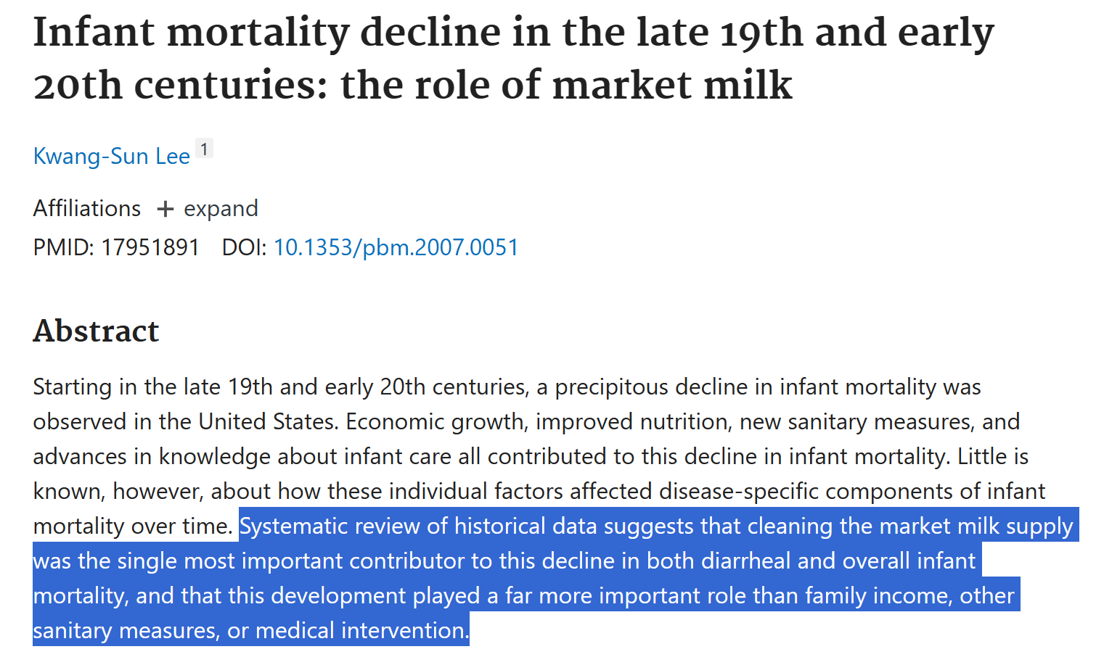
Lee, Kwang-Sun. (2007). Infant Mortality Decline in the Late 19th and Early 20th Centuries: the role of market milk. Perspectives in Biology and Medicine, 50(4), 585–602. https://doi.org/10.1353/pbm.2007.0051

Slide 4
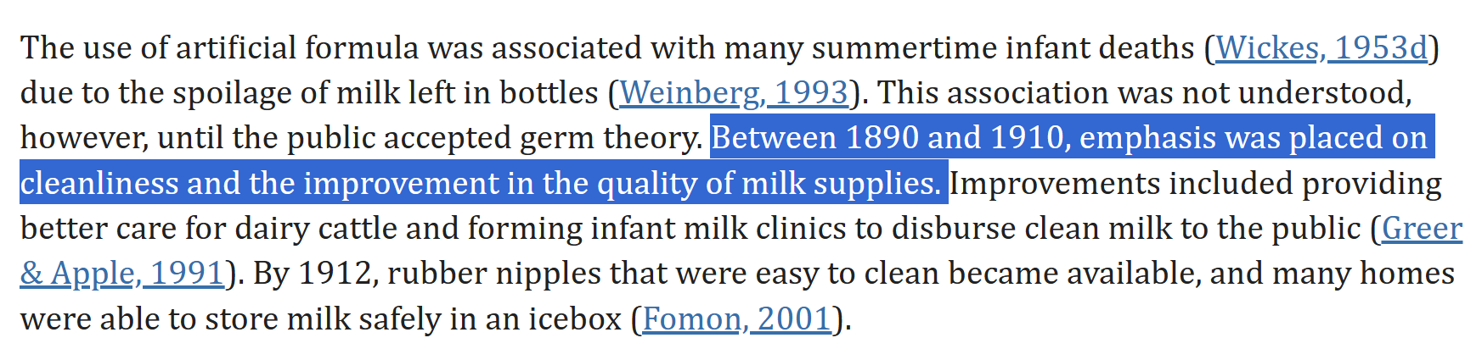
Stevens, E. E., Patrick, T. E., & Pickler, R. (2009). A History of Infant Feeding. Journal of Perinatal Education, 18(2), 32–39. https://doi.org/10.1624/105812409x426314

Slide 5
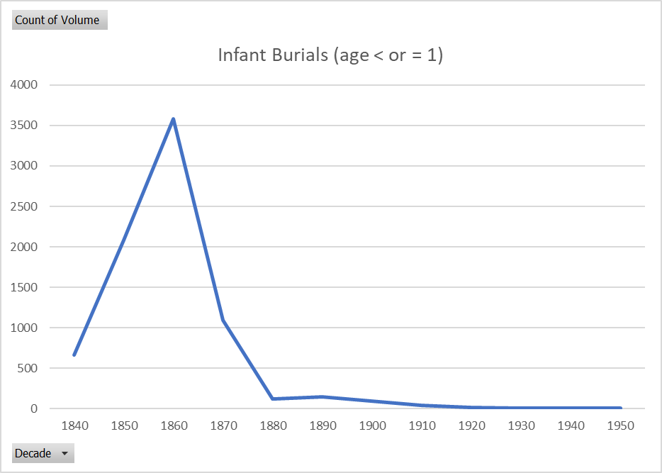

Slide 6
